Slide 1
FIN 740: Corporate Finance
Topic #2
Time Value of Money

Slide 2
Agenda for this topic
Discuss the “time value of money” and its importance
Define present versus future value
Cover mathematical concepts key to course; e.g.,
How to value a stream of cash flows
How to calculate net present value (NPV)
How to apply annuity and perpetuity formulas
Lots of application problems

Slide 3
Motivation
Our goal is to understand how managers decide whether a particular course of action will create value
How did Disney decide in 2019 it should launch Disney+?
How did Apple decide in 2015 to produce the Apple Watch?
How did Amazon decide in 2017 to buy Whole Foods?
Intuitively, how do you think managers make such decisions?

Slide 4
Answer = Cost-benefit analysis
Financial managers need to weigh the costs and benefits of every decision they make
Intuitively, good decisions are those where benefits exceed the costs
This logic applies to all decisions we will discuss in this course: capital budgeting, capital structure, and payout policy

Slide 5
Identifying costs and benefits
Quantifying costs & benefits will require skills and inputs from all other areas of management disciplines
Marketing
Economics
Organizational behavior
Strategy
Operations
Finance touches everyone within a firm!

Slide 6
Key idea of this course & unit =
Managers must make sure these costs and benefits are expressed in similar ‘units’; e.g., two examples…
#1 – Should firm trade 200 oz. of silver (cost) for 10 oz. of gold (benefit)?
#2 – Should company invest $1 million (cost) today in machine that will return $1.08 million cash flows (benefit) next year?
How would you convert these costs & benefits into similar units?

Slide 7
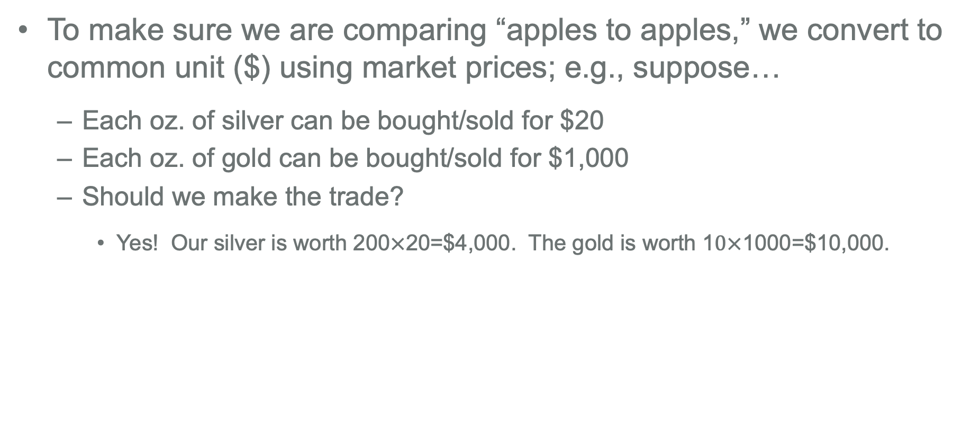
Example #1 – Converting units using market prices
To make sure we are comparing “apples to apples,” we convert to common unit ($) using market prices; e.g., suppose…
Each oz. of silver can be bought/sold for $20
Each oz. of gold can be bought/sold for $1,000
Should we make the trade?
Yes! Our silver is worth 200$×$20=$4,000. The gold is worth 1$0×$1000=$10,000.
What if we don’t need gold for our products? Do we make the trade then?

Slide 8
Summary – Use market prices to covert to dollars
Basic idea: convert all costs & benefits to dollars today
If $ benefits today exceed $ costs today, you do it; it creates value
If not, don’t do it; it destroys value
This benefits – costs calculation is what we call a “Net Present Value.” We’ll return to this later.

Slide 9
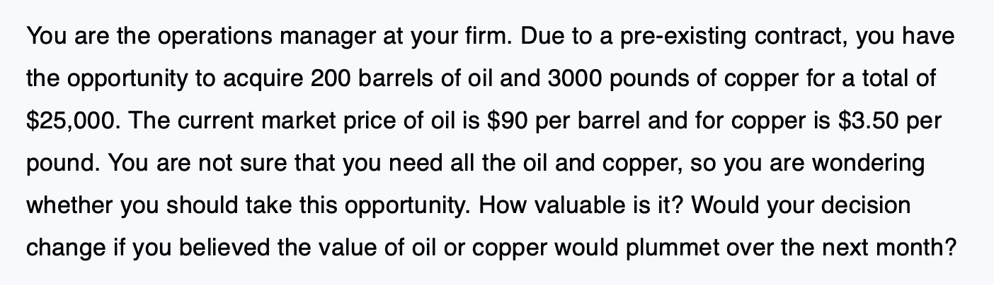
Practice question [Example 3.2 from textbook]
Take 5 minutes to answer below question

Slide 10
A note on where to find typed solutions
For most of these textbook practice questions [like the last one], I will work out the solutions on the whiteboard, but you can always find a detailed solution in the textbook
I.e., there is no need to copy down what I write on the whiteboard

Slide 11
Time value of money
Financial managers also need to compare costs and benefits at the same point in time to make a valid comparison
Two cash flows at different points in time have different values
I.e., a $ received today is worth more than a $ received in one year [Why?]
This is referred to as the “time value of money”

Slide 12
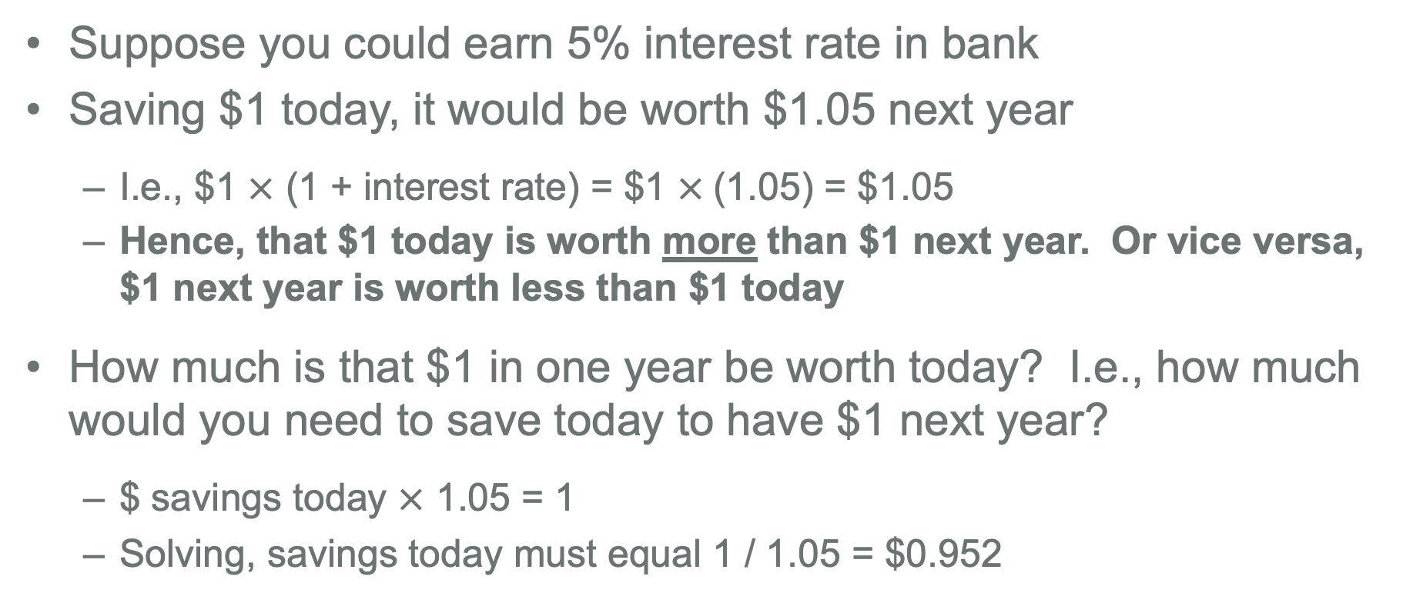
Time value of money [continued]
Suppose you could earn 5% interest rate in bank
Saving $1 today, it would be worth $1.05 next year
I.e., $1 $×$ (1 + interest rate) = $1 $×$(1.05) = $1.05
Hence, that $1 today is worth more than $1 next year. Or vice versa, $1 next year is worth less than $1 today
How much is that $1 in one year be worth today? I.e., how much would you need to save today to have $1 next year?
$ savings today $×$ 1.05 = 1
Solving, savings today must equal 1 / 1.05 = $0.952

Slide 13
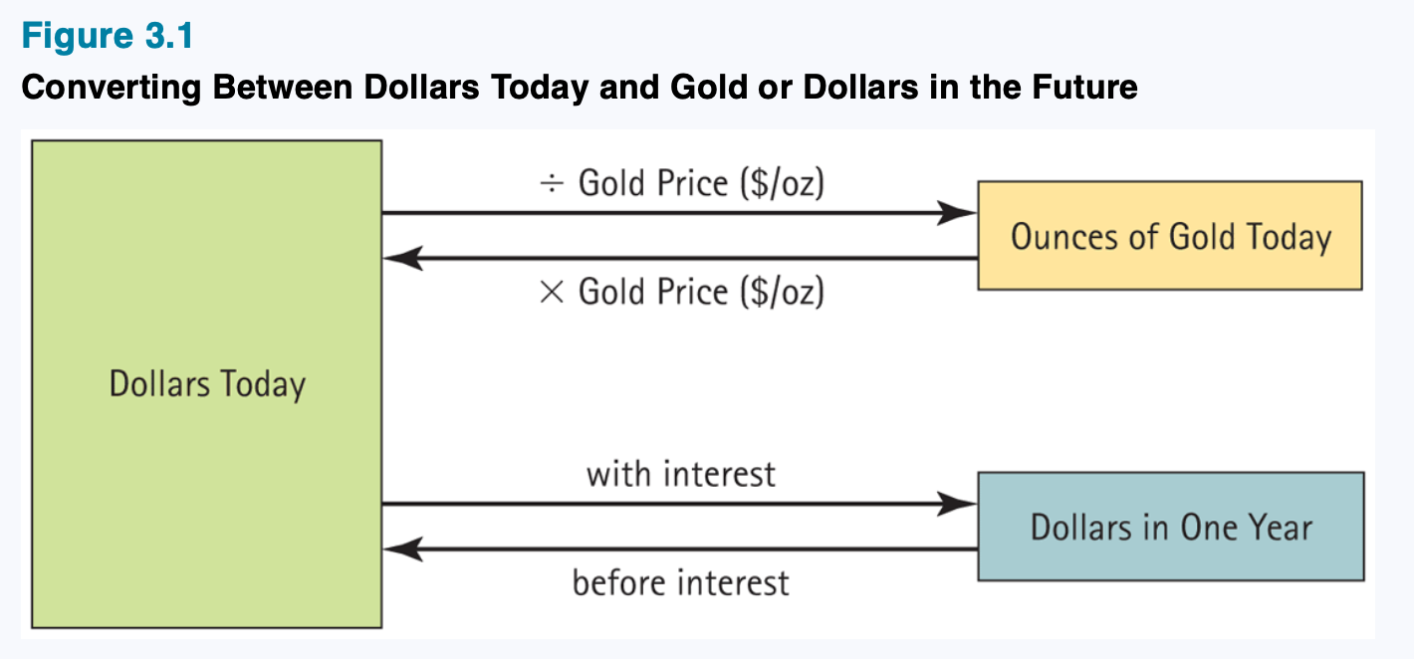
Converting cash flows using interest rates
Interest rates are way to compare values of cash at different points in time; it is the ‘market price’ of moving cash across time
Figure 3.1: Berk, Demarzo, and Harford, Fundamentals of Corporate Finance, 5th Edition

Slide 14
Example #2 – Converting using interest rates
Return to the earlier example, and now suppose the company can borrow & invest at 10% risk-free, interest rate
Should company invest $1 million (cost) today in machine that will return $1.08 million cash flows (benefit) next year?
There are two different ways to answer this question; both will always give the same answer
Compare future values of costs & benefits
Compare present values of costs & benefits

Slide 15
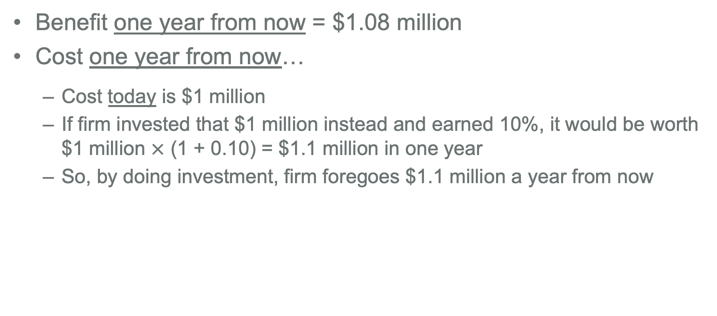
Future value comparison
Benefit one year from now = $1.08 million
Cost one year from now…
Cost today is $1 million
If firm invested that $1 million instead and earned 10%, it would be worth $1 million $×$ (1 + 0.10) = $1.1 million in one year
So, by doing investment, firm foregoes $1.1 million a year from now
Future value of benefit ($1.08 million) in is less than the future value of cost ($1.10 million)… You should not do the investment!

Slide 16
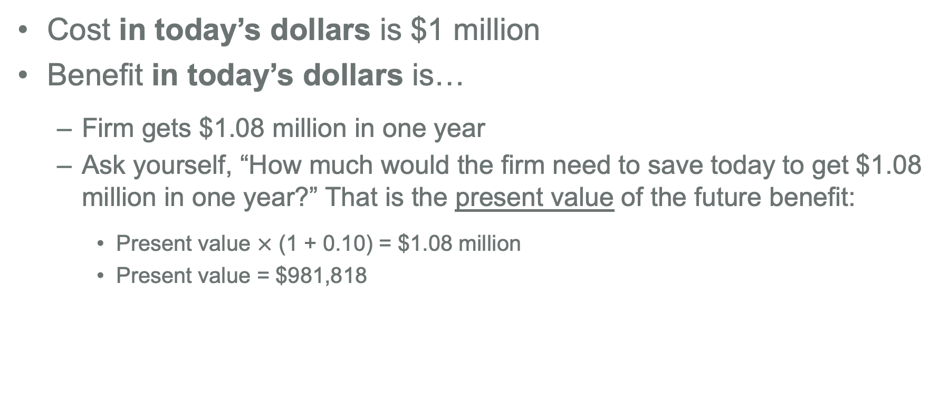
Present value comparison
Cost in today’s dollars is $1 million
Benefit in today’s dollars is…
Firm gets $1.08 million in one year
Ask yourself, “How much would the firm need to save today to get $1.08 million in one year?” That is the present value of the future benefit:
Present value $×$ (1 + 0.10) = $1.08 million
Present value = $981,818
Present value of benefit ($981,818) in is less than present value of the cost ($1 million)… Again, you should not do the investment!

Slide 17
Quick recap so far…
To evaluate a decision, must value incremental costs & benefits
To compare costs & benefits that occur at different points in time, we must convert them all into values in today’s dollars
A dollar one year from now is worth less than a dollar today
Can convert future cash flow, C, to a present value (PV) using the discount rate, r; specifically, PV = C / (1+r)
Otherwise, you make a “Henry” mistake…
Now, we will talk more about net present value (NPV)… Do you recall what it was?

Slide 18
Net present value (NPV)
In Finance, we typically do comparisons using present values
First, convert all future costs & benefits to present values
Then, calculate net present value (NPV), where
When should you do a project?
If choosing between projects, how might you do that?
NPV = Present value(benefits) – Present value(costs)

Slide 19
NPV decision rule
If deciding whether to accept or reject a particular project, you accept the project if its NPV > 0!
Positive NPV project creates value; share price will go up
Negative NPV projects destroy value; share price will fall
If choosing between multiple investments [and you can only pick one], choose the one with the highest NPV

Slide 20
Basic tools of financial decision making
The evaluation of financial decisions involves computing the net present value of a project’s cash flows
We will now cover 4 topics that will help you do this:
Using timelines
Three rules for valuing cash flows
Valuing a stream of cash flows
Valuing perpetuities and annuities

Slide 21
Using Timelines
Cash flows from projects can be complicated!
Some years will be negative, some will be positive
And cash flows can occur over many years
So, it is important to create timelines to keep track of when cash flows occur and whether they are an outflow or inflow
We typically do this in MS Excel (where each column or row represents a different period); you’ll see examples of this later in the next case

Slide 22
Timelines – The Basics
Designating the timing
Put cash flows that occur immediately at date t = 0
Put cash flows that occur one year from now at date t = 1
Put cash flows that occur two years from now at date t = 2
And so on…
Inflows versus outflows
Inflows are positive cash flows
Outflows are negative cash flows, which are indicated with a minus sign

Slide 23
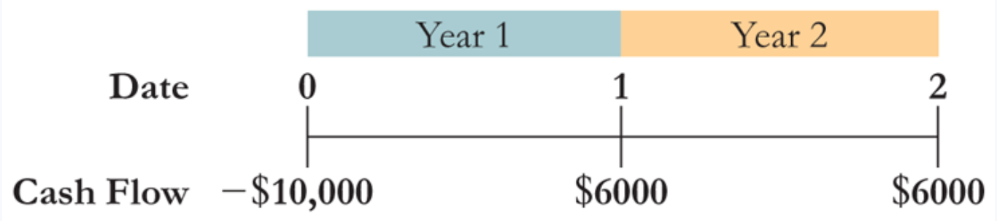
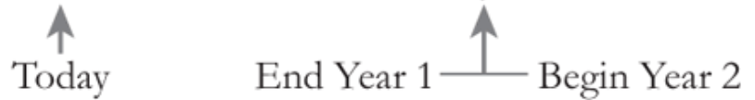
Example timeline
Product costs $10,000 to launch
Generates positive cash flows of $6,000 one year from now and and two years from now
Negative because it is an outflow

Slide 24
Three rules for valuing cash flows
Only values at same point in time can be compared or combined
To calculate a cash flow’s future value, we must compound it
To calculate a cash flow’s present value, we must discount it

Slide 25
Rule #1 – Compare values at same point in time
Returning to prior example, we can’t directly compare or combine the cash flows because they occur at different times
To do a proper comparison, we need to apply Rules #2 and #3 to convert all cash flows to the same time period…

Slide 26
Rule #2 – Finding future values of cash flows
To move a cash flow forward in time, you must compound it
Let’s do an example:
Suppose you have can receive $1,000 today or $1,200 in two years
You can earn 10% annually on the $1,000 today if you invest it
Which is better? To answer, you could find future value of that $1,000 today and compare it to the $1,200 in two years [see next slide]

Slide 27
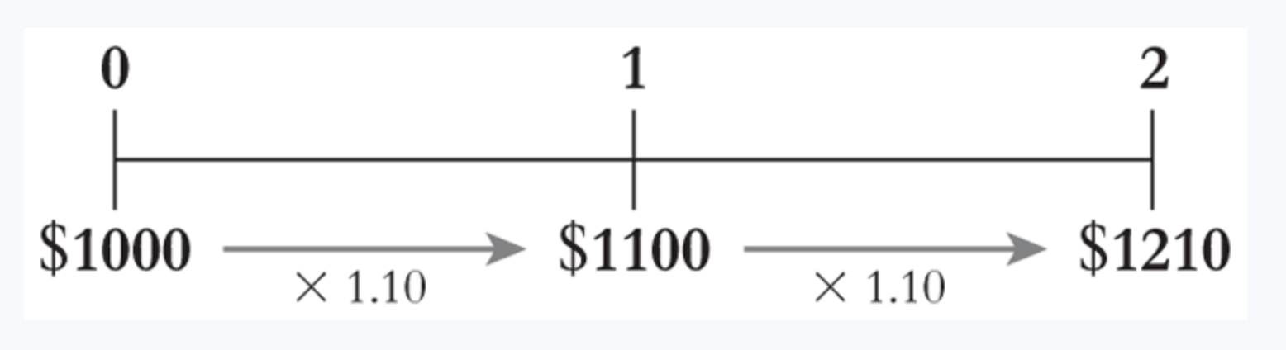
Rule #2 – Example continued
In this example, you prefer $1,000 today
$1,000 today has the same value as $1,210 in two years, which is greater than the $1,200 you could get otherwise

Slide 28

Rule #2 – Future value formula
More generally, for the cash flow C that occurs today, its future value (FV) in year n using interest rate r is given by

Slide 29
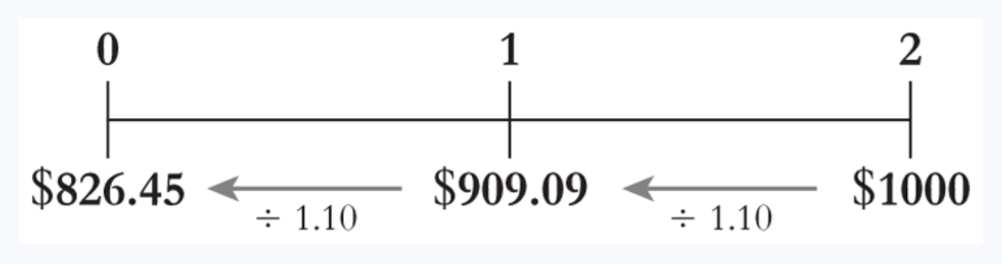
Rule #3 – Finding present values of cash flows
To move a cash flow back in time, you must discount it
Let’s do an example:
Firm will receive $1,000 two years from now
Current interest rate is 10%
What is present value of that $1,000 today?

Slide 30
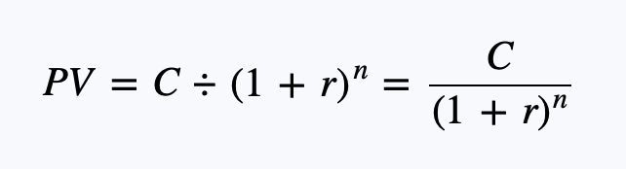
Rule #3 – Present value formula
More generally, we can calculate the present value of cash flow C that occurs n years away using

Slide 31

Practice question [Example 3.4 from textbook]
Take 5 minutes to answer below question

Slide 32
Valuing a stream of cash flows
Can combine the 3 rules to value an entire stream of cash flows
Basic idea = Calculate present value of each cash flow; then add them all together to find total present value!
Let’s do this now using earlier example
Product costs $10,000 to launch
Generates cash flow of $6,000 both one and two years from now
We’ll assume appropriate discount rate is 10%

Slide 33


Valuing cash flow streams – Example
The present value of all three cash flows is $413.22
$5,454.55
$$÷1.10$$
$$÷{1.10}^{2}$$
$4,958.68
Total = $413.22

Slide 34
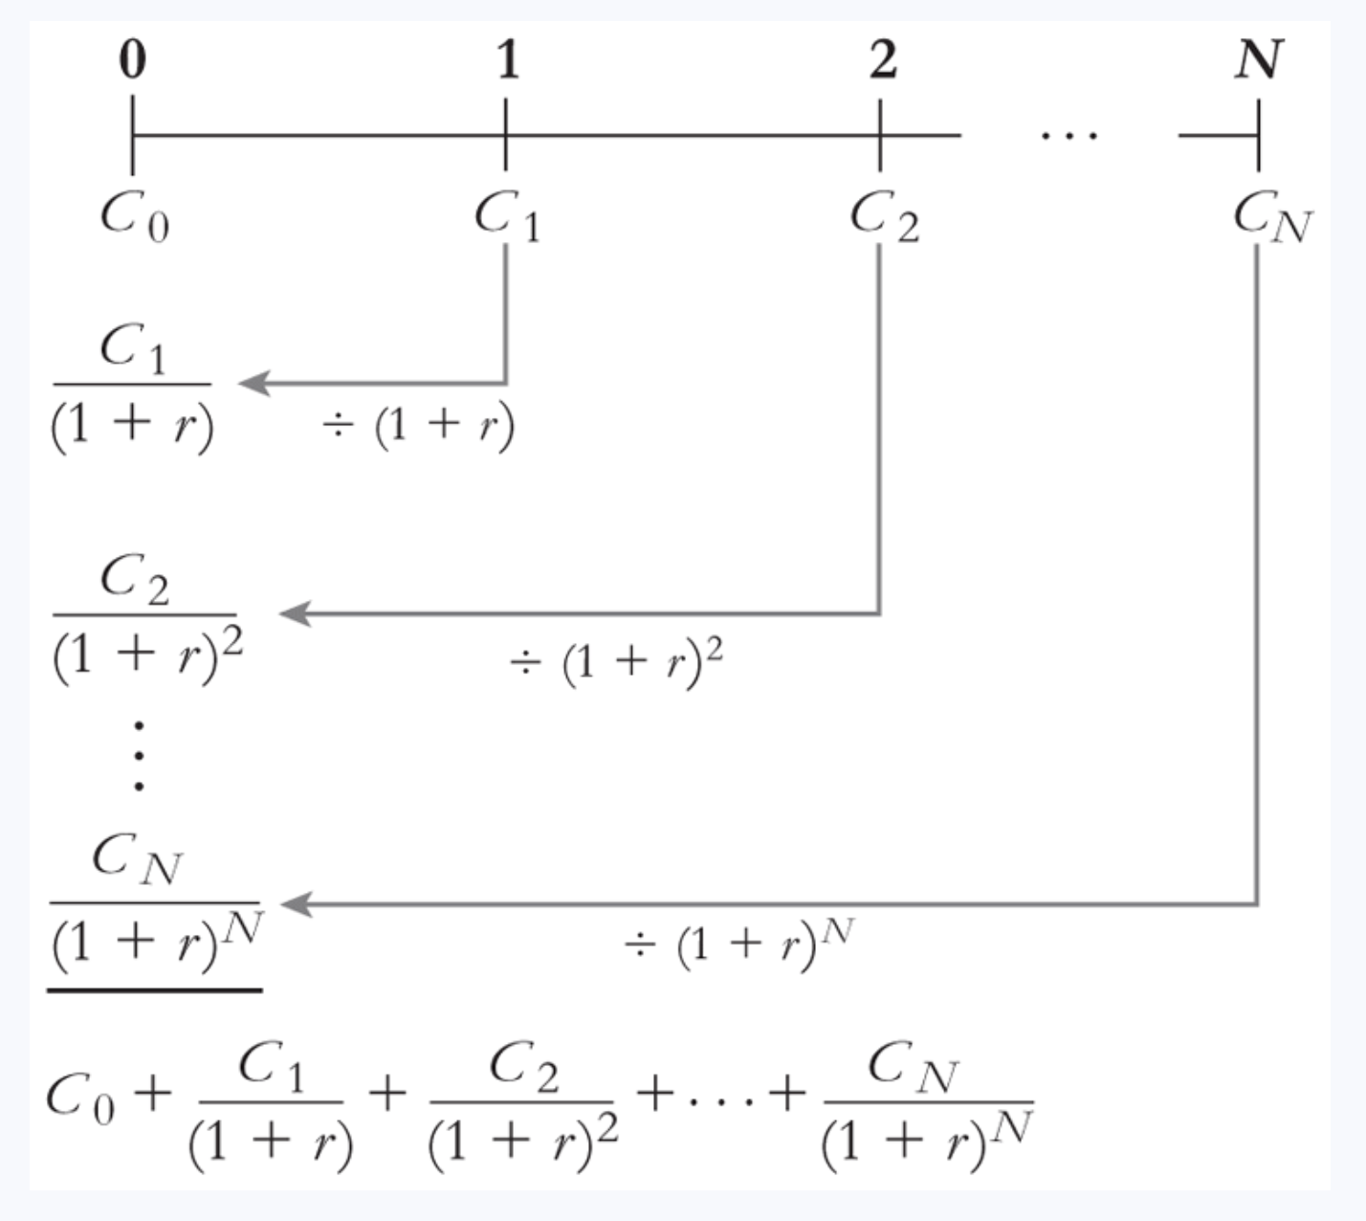
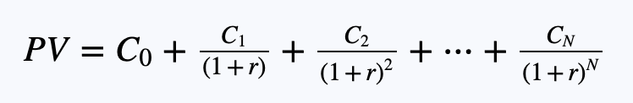
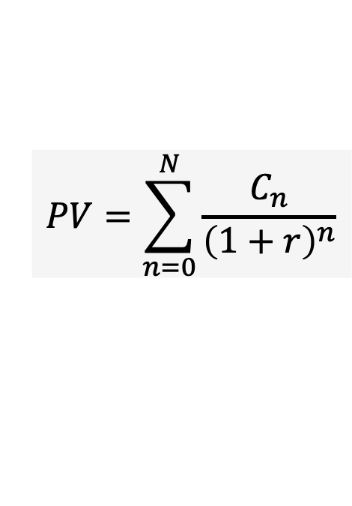
General formula for valuing stream of cash flows
Applying the rules more generally, we can express present value (PV) of a cash flow stream using:
$$PV=\sum_{n=0}^{N}{\frac{C_{n}}{{\left(1+r\right)}^{n}}}$$

Slide 35
Valuing perpetuities and annuities
In next few slides, I’ll show you shortcuts you can use to find the present value for two common types of cash flow streams
Note: I’m not showing you how these formulas are derived; if you are interested in that, please see Chapter 4 of textbook
The two cash flows are:
Perpetuity
Annuity
What type of cash flow stream do they each refer to?

Slide 36
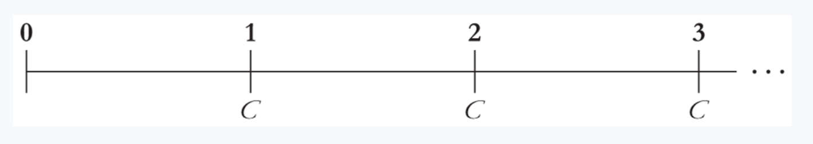

Formula to value a perpetuity
Perpetuity = a stream of equal cash flows that occurs at regular intervals and lasts forever
To find present value, simply divide cash flow by the interest rate
Notice first cash flow always starts one period away! This will also be true for annuities.

Slide 37
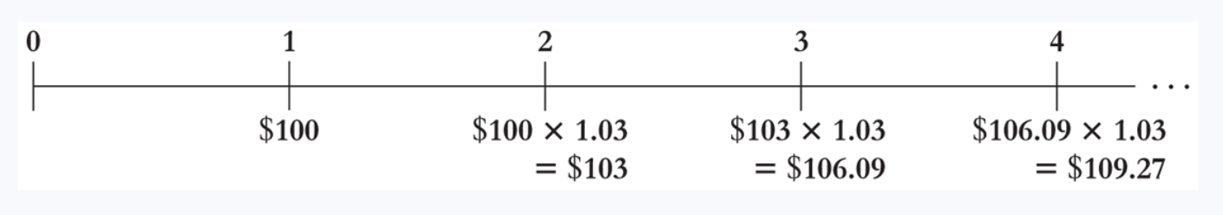
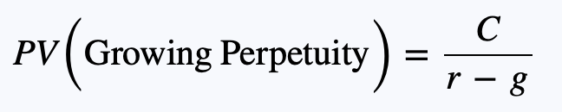
Formula to value a growing perpetuity
Now, the cash flow each period grows at a constant rate g
For example, a growing perpetuity where the first payment is $100 and grows at 3% would look like:
To value, use:
C is the first cash flow; in this example, it would be $100

Slide 38
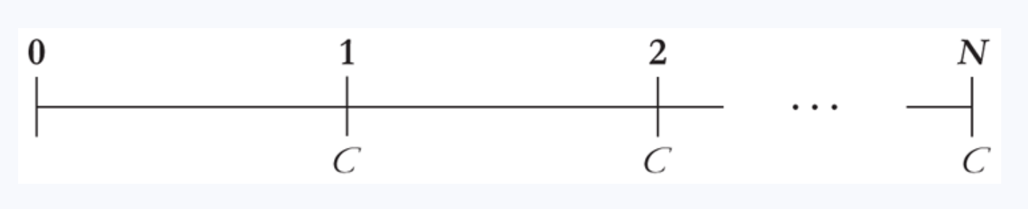
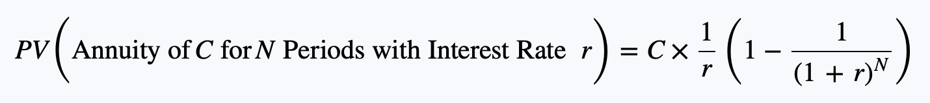
Formula to value an annuity
Annuity = a stream of equal cash flows arriving at a regular interval and ending after a specific period
To find present value, use the below formula:
Ends after N periods

Slide 39
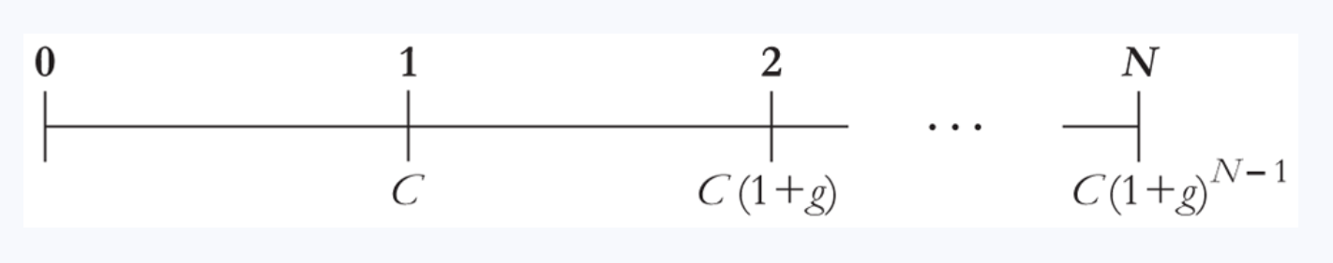
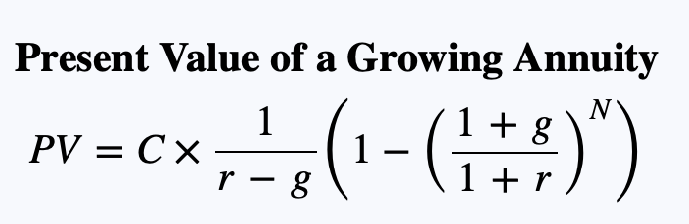
Formula to value a growing annuity
Now, the cash flow each period grows at a constant rate g [but still ends after N periods, because it is an annuity]
To value, use:

Slide 40
Practice question
Take 5 minutes to answer below question
Your firm is considering an investment that will cost it $5,000 immediately, but it will generate cash flows of $3,000 one year from now, $2,000 two years from now, and $1,000 three years from now. If the appropriate discount rate is 7%, should the firm do the project?

Slide 41
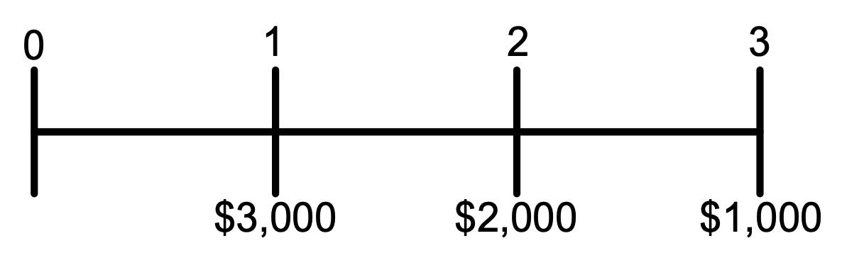
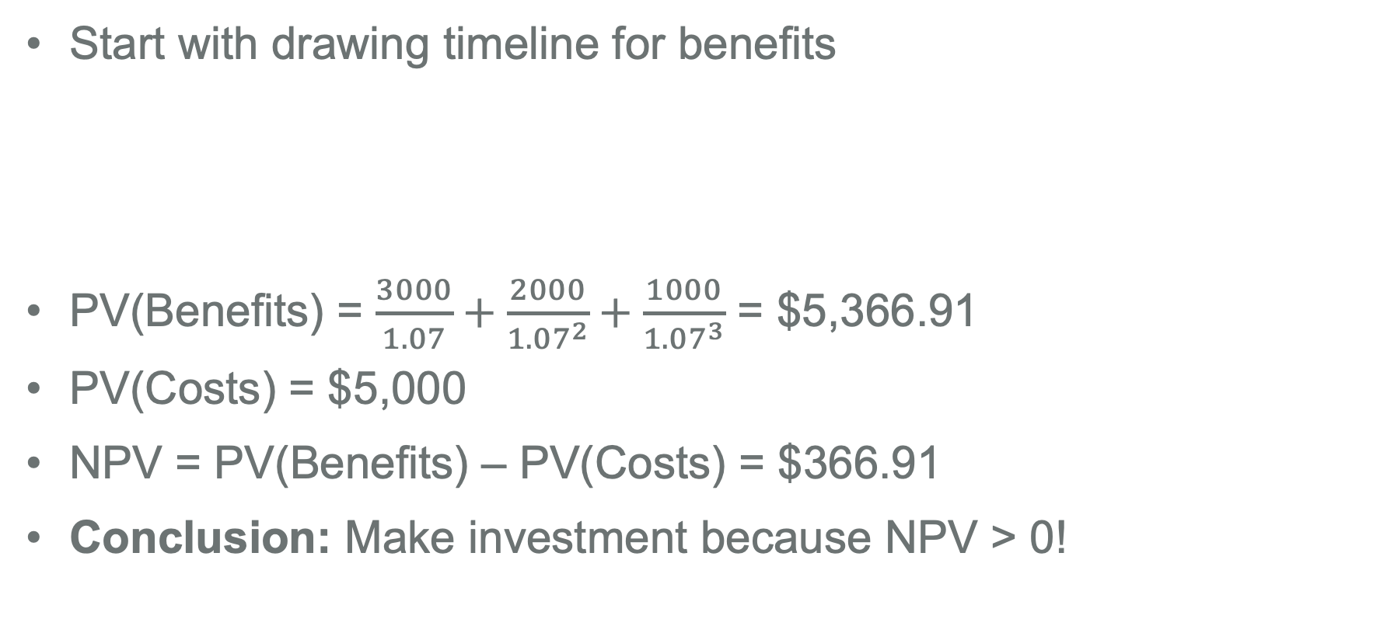
Solution to practice question
Start with drawing timeline for benefits
PV(Benefits) = $\frac{3000}{1.07}+\frac{2000}{{1.07}^{2}}+\frac{1000}{{1.07}^{3}}$ = $5,366.91
PV(Costs) = $5,000
NPV = PV(Benefits) – PV(Costs) = $366.91
Conclusion: Make investment because NPV > 0!

Slide 42
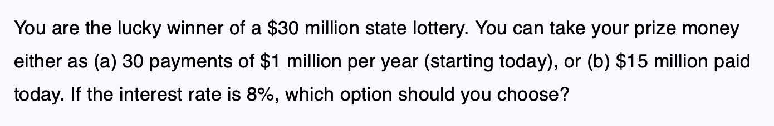
Practice question [Example 4.4 from textbook]
Take 5 minutes to answer below question

Slide 43
Tip #1: Use MS Excel functions to solve stuff
MS Excel has a lot of functions that can solve these quickly
E.g., in the prior example, you could have gotten the present value of the 29-year annuity using the PV function:
Note! This formula will give you negative value of -11.18 because Excel thinks of PMT as outflow payment. So, you should instead put -1,000,000 as PMT, not 1,000,000.
Tells Excel the interest rate = 8%
Tells Excel annual cash flow is 1,000,000
Tells Excel the number of periods is 29

Slide 44
Tip #2: Make sure time periods match
The interest rate, r, in these formulas represents the interest rate for the period of the cash flow
If cash flows occur annually, then use the annual interest rate
If cash flows occur monthly, then use the monthly interest rate
And so on…

Slide 45
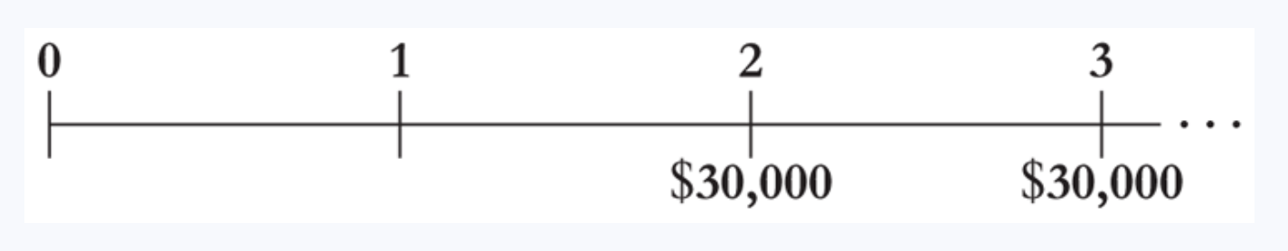
Tip #3: Be careful with timing in formulas
E.g., suppose company has project that will generate $30,000 per year forever starting two years from now
If the appropriate discount rate is 8%, is the value of this project equal to $30,000 / 0.08 = $375,000?

Slide 46
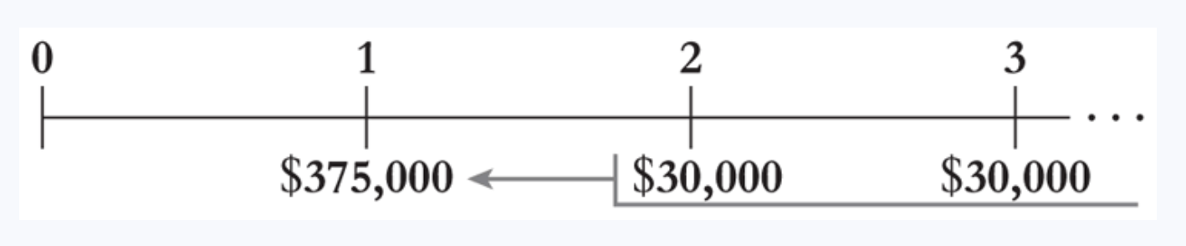
Avoid this common mistake!
No. $375,000 is value in year 1.
Perpetuity and annuity formulas always find value one period before the first cash flow. In this case, that would be year 1.
To find present value, we need to discount it back one more time
I.e., Present value = $375,000 / 1.08 = $347,222

Slide 47
Tangent – Solving for other variables
Can use same formulas to solve for other variables
E.g., Present value of annuity formula is what banks use to solve for your loan payment on a mortgage or car loan
PV(annuity) = value of the loan
r = interest rate they want to charge you (per period)
N = number of periods
C = what bank solves for… it’s the payment you need to make each period to ensure the value of the payments you make equal the value of the loan!
Let’s do an example…

Slide 48
Example – Solving for payment on a loan
Suppose your firm wants to borrow $100,000 from the bank
They bank offers a 10-year loan, where your firm will make one payment per year, starting one year from now, with 10 payments in total
The interest rate is 8%
What is your annual loan payment going to be?

Slide 49
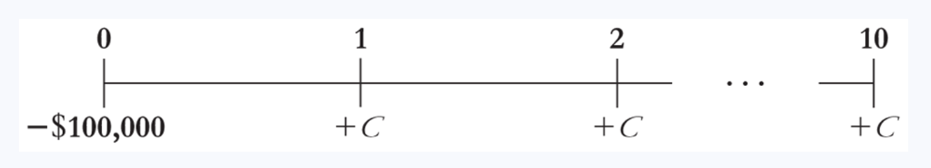
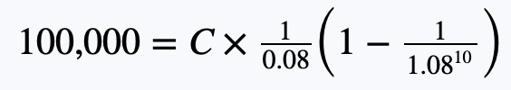
Example – Solving for payment on a loan [Part 2]
From bank’s perspective, cash flows look like:
And your 10 payments of C need to have PV of $100,000; i.e.,
Solving for C, we find C = $14,902.95

Slide 50
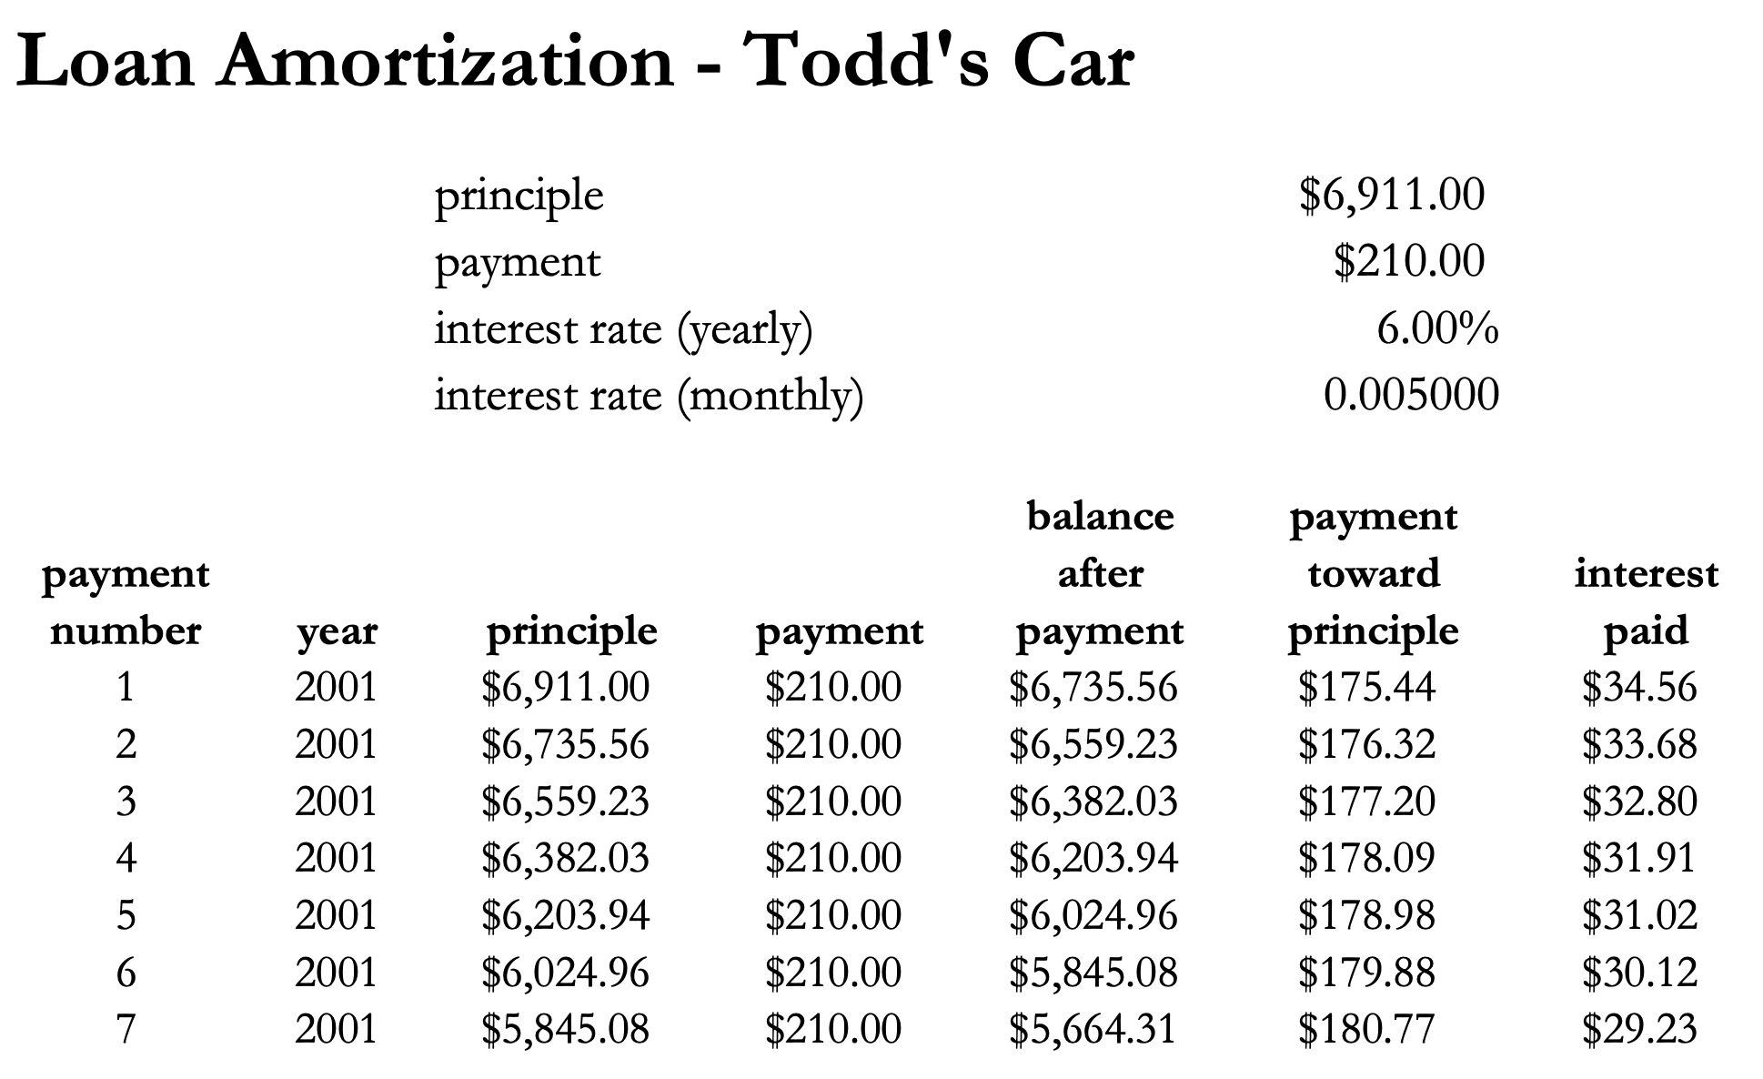

Example – Loan amortization table
!

Slide 51
A quick note on interest rates
When using interest rates to transfer values across time, need to use interest rate that reflects the riskiness of those cash flows
If cash flows are risk-free, use the risk-free interest rate you could receive otherwise as the discount rate (i.e., r)
If cash flows are risky, you want to use the interest rate you could earn on an investment of similar risk
We will talk more about risk later…

Slide 52
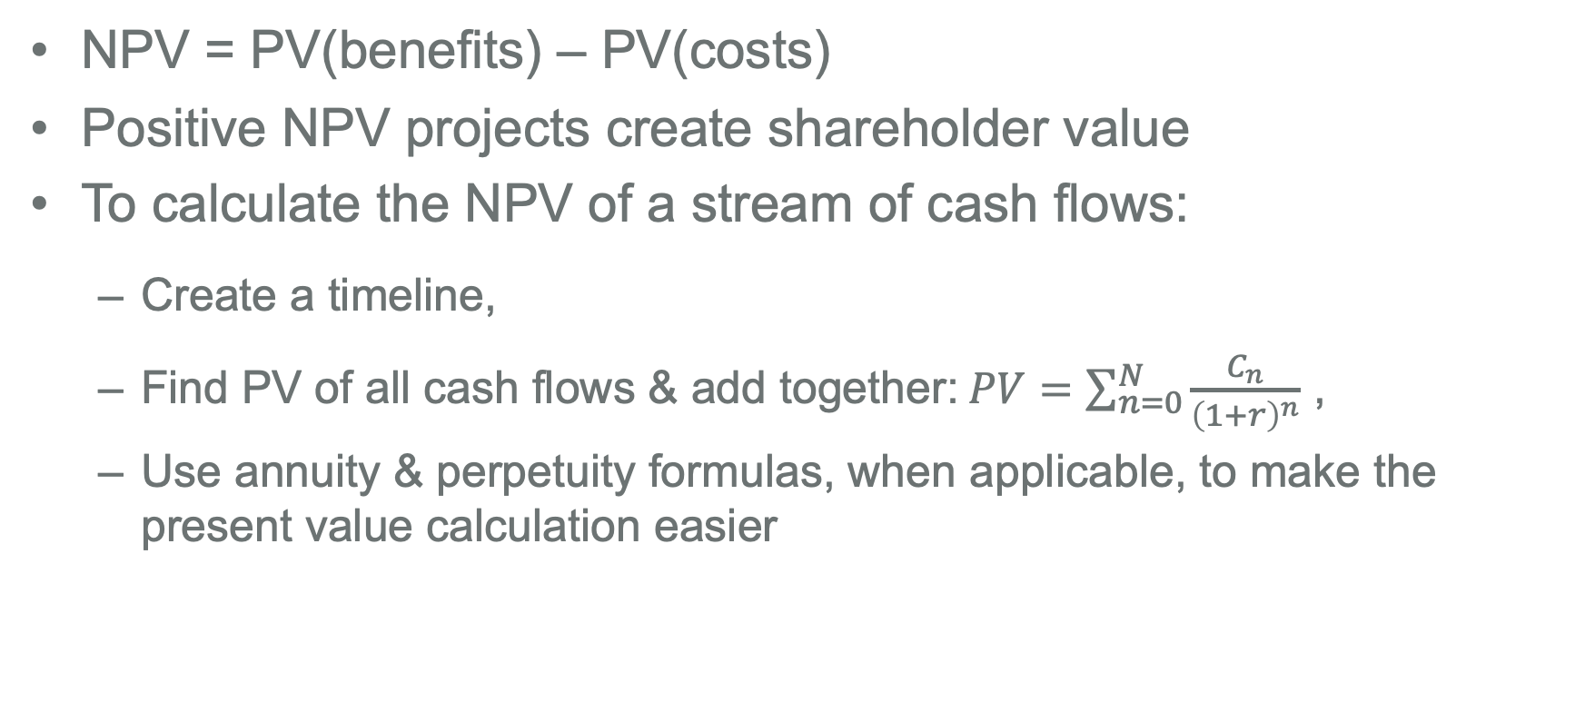
Key points to remember
NPV = PV(benefits) – PV(costs)
Positive NPV projects create shareholder value
To calculate the NPV of a stream of cash flows:
Create a timeline,
Find PV of all cash flows & add together:$PV=\sum_{n=0}^{N}{\frac{C_{n}}{{\left(1+r\right)}^{n}}}$ ,
Use annuity & perpetuity formulas, when applicable, to make the present value calculation easier
See MyLab Finance homework for yet even more opportunities to practice these concepts & calculations

Slide 53
Group breakout session
Take 25 minutes as group to value the below project. This is ungraded and more difficult… See if you can do it.
Your employee has approached you with a project that she thinks will create a lot of value for your firm’s shareholders. The project will generate $15,000 in cash flows one year from now, and after that, the cash flows will grow by 10% per year for 3 years. After these initial 4 cash flows, the growth rate will stabilize at 5% per year. There is no upfront cost to launch the project, but it will require $5,000 in expenses every year, with the first expense being in one year. If the appropriate discount rate for the project is 20%, what is the NPV of the investment?

Slide 54

First, I’ll find PV(Costs)
This is a perpetuity, where the cash flow is -$5,000 each year
Present value = -5000 / 0.20 = -$25,000
I.e., PV(Costs) = $25,000

Slide 55
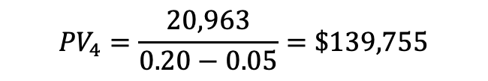
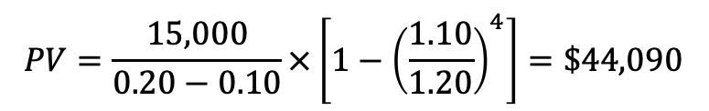
Next, I’ll find PV(Benefits)
I will divide this into two separate cash flow streams
This is a 4-year growing annuity, where C = $15,000 and g = 10%
This is a growing perpetuity, where C = $20,963, g = 5%, and first cash flow is in year 5
$${PV}_{4}=\frac{20,963}{0.20−0.05}=\$139,755$$
$$PV=\frac{15,000}{0.20−0.10}×\left[1−{\left(\frac{1.10}{1.20}\right)}^{4}\right]=\$44,090$$
Note! This value is as of year 4

Slide 56
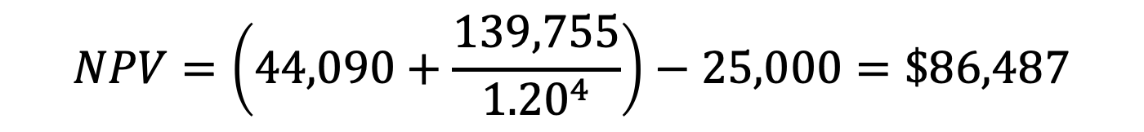
Bringing it all together for NPV
NPV = PV(Benefits) – PV(Costs)
$$NPV=\left(44,090+\frac{139,755}{{1.20}^{4}}\right)−25,000=\$86,487$$
Taking present value of that PV₄ value

